Slide 1
PROFESSOR VELAZQUEZ
INTRODUCTION
TO
MICROECONOMICS
MODULE 01 · OVERVIEW OF ECONOMIC THOUGHT AND MODELING
FALL 2025

Slide 2
01
Overview of Economic
Thought and Modeling
Section I builds the method of economic reasoning. Section II builds three foundational models of the course: the budget constraint, the production possibilities model, and comparative advantage.
MODULE

Slide 3
MODULE 1
Agenda, Big Questions & Do Now
BIG QUESTIONS
PRE-WORK
WHAT YOU'LL NEED
(1) What are the foundational principles of economic analysis, and how do economists construct valid arguments?
(2) How do economists model the tradeoffs faced by consumers and producers under scarcity?
· Read Chapters 1–2 and the Syllabus
· Complete the Module 1 Vocabulary Checklist
· Khan Academy: Basic Economic Concepts, Quizzes 1–3
· Bring the Module 1 Worksheet
· Module 1 Worksheet (printed)
· Pencil, straight-edge, calculator
· Graph paper for Parts 4–6
· Laptop for the classroom budget-constraint app
AGENDA — DAY 1 (1 hr 15 min) | TIME | AGENDA — DAY 2 (1 hr 15 min) | TIME
Do Now + Logistics | 20 min | Do Now: Table → Equation → Graph | 5 min
Part 1 — Scientific method & reasoning | 20 min | Part 4 — Budget constraint | 25 min
Part 2 — Scarcity & opportunity cost | 20 min | Part 5 — Production possibilities model | 25 min
Part 3 — History of economic thought | 15 min | Part 6 — Comparative advantage & trade | 20 min
INTRO TO MICROECONOMICS | PROF. VELAZQUEZ
MODULE 1: OVERVIEW OF ECONOMIC THOUGHT AND MODELING

Slide 4
YOU TRY
Do Now — The Distribution Problem
There is ONE Hershey Kiss for everyone in this class to share.
What is the BEST SYSTEM to decide how to distribute this single piece of chocolate?
Write down your system. Then name the value judgment it rests on — efficiency? equality? need? merit? first-come?
Hold onto your answer. Every module this semester is a variation on this question.
5
MIN
INTRO TO MICROECONOMICS | PROF. VELAZQUEZ

Slide 5
BEFORE WE BEGIN
Vocabulary Checklist — Module 1
Scarcity
Opportunity Cost
Factors of Production
Positive Statement
Normative Statement
Ceteris Paribus
Natural Experiment
Rational Behavior
Marginal Analysis
Marginal Benefit
Marginal Cost
Budget Constraint
Feasible Set
Production Possibilities Model
Law of Increasing Opp. Cost
Comparative Advantage
Absolute Advantage
Gains from Trade
Models as Maps
Bounded Rationality (preview)
Define each term BEFORE lecture. We will use every one of them today.
INTRO TO MICROECONOMICS | PROF. VELAZQUEZ
MODULE 1: OVERVIEW OF ECONOMIC THOUGHT AND MODELING

Slide 6
SECTION I
Economic Thought & Method
Part 1 · The scientific method, positive vs. normative, micro vs. macro, short-run vs. long-run
Part 2 · Scarcity, choice, opportunity cost, the factors of production, and marginal behavior
Part 3 · Models as maps; classical, neoclassical, behavioral and heterodox traditions

Slide 7
01
The Scientific Method
& Economic Reasoning
PART
OBJECTIVE Apply the scientific method to economic questions; distinguish positive from normative statements; define micro vs. macro and short-run vs. long-run.
INTRO TO MICROECONOMICS | PROF. VELAZQUEZ
MODULE 1: OVERVIEW OF ECONOMIC THOUGHT AND MODELING

Slide 8
PART 1 · FORMS OF REPRESENTATION
One Economic Idea, Three Mathematical Forms
Plato's Theory of Forms gives us a useful analogy: the same underlying relationship can appear in different forms. In economics we move constantly between three representations of identical information.
1
Tabular Form — DATA
2
Mathematical Form — RELATIONSHIP
3
Graphical Form — MODEL
Rows and columns organize quantities, values, categories and observations. A table lets us identify patterns numerically and linguistically, and to read change in the margins between rows.
Equations use numbers, variables and symbols to express how economic quantities relate. They describe the relationship precisely and let us calculate values not shown directly in the data.
A coordinate plane translates the relationship into space and shape. Axes represent variables; points, lines, slopes and curves make direction, magnitude and change visible.
THE RULE FOR THIS COURSE
TABLE → EQUATION → GRAPH. Different representations, one economic relationship. You will be asked to move between all three on every assessment.
INTRO TO MICROECONOMICS | PROF. VELAZQUEZ
MODULE 1: OVERVIEW OF ECONOMIC THOUGHT AND MODELING

Slide 9
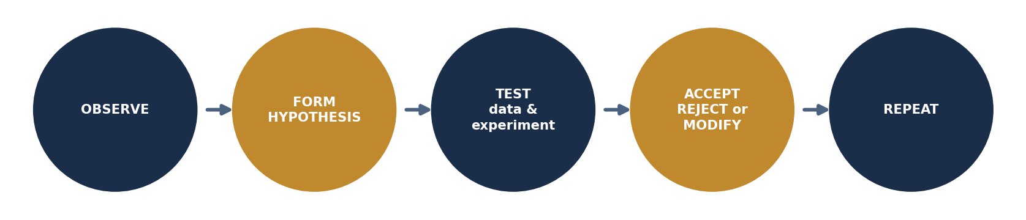
PART 1 · EMPIRICAL RESEARCH
How Do We Know Anything About Economics?
Using the scientific method, economists make statistically significant generalizations about the world — or test economic hypotheses — through natural experiments, laboratory experiments, data engineering and data analysis.
CETERIS PARIBUS
DID YOU KNOW?
"All other things remaining the same." Economists isolate variables so that nothing but the thing of interest is changing.
A Ph.D. in economics stands for Doctor of Philosophy, and is focused on the quantitative social sciences.
INTRO TO MICROECONOMICS | PROF. VELAZQUEZ
MODULE 1: OVERVIEW OF ECONOMIC THOUGHT AND MODELING

Slide 10
PART 1 · FORMAL DEFINITIONS
Positive vs. Normative Statements
POSITIVE STATEMENT — what IS
NORMATIVE STATEMENT — what OUGHT to be
A descriptive, testable claim about a phenomenon occurring at or over a specific point in time. It must be grounded in fact or in a clear cause-and-effect relationship, and it can in principle be confirmed or refuted by data.
EXAMPLE: "In 1933, the U.S. unemployment rate rose to 25%."
A prescriptive claim that incorporates a value judgment about how things should be. It cannot be settled by data alone, because it rests on a standard of what is desirable — efficiency, equality, liberty, need.
EXAMPLE: "In the U.S. economy, a desirable unemployment rate is around 4% to 5%."
NATURAL EXPERIMENT
WHY THIS DISTINCTION MATTERS
WATCH FOR
An empirical study in which the assignment of a treatment is determined by nature, policy, or historical accident rather than by the researcher. It approximates a randomized trial using events that have already happened — a border change, a lottery, a sudden law.
Nearly every policy dispute mixes the two. Disagreement about a positive claim is resolved with better evidence. Disagreement about a normative claim is not — it is a disagreement about values, and must be argued on those terms.
Words that smuggle normative content into apparently positive claims: should, ought, unfair, excessive, too high, deserves, needs. A positive statement can still be false — being testable is not the same as being true.
Positive analysis tells you what the world does. Normative analysis tells you what to do about it. Economics needs both — but never confuse one for the other.
INTRO TO MICROECONOMICS | PROF. VELAZQUEZ
MODULE 1: OVERVIEW OF ECONOMIC THOUGHT AND MODELING

Slide 11
PART 1 · SCOPE & TIME HORIZON
Micro vs. Macro · Short-Run vs. Long-Run
MICROECONOMICS
MACROECONOMICS
The study of decision-making by individual customers, workers, households and firms — a smaller system, or a single speck within the glitter.
"Thinking about how a part of the game works."
This course is a microeconomics course.
The study of the economy as an aggregate system: economic growth, the business cycle, interest rates, inflation, unemployment and government policy — the entire system of glitter.
"Thinking about the whole game."
SHORT-RUN
LONG-RUN
A time horizon over which at least one accessible resource is FIXED. Producers cannot adjust every input; consumers cannot fully re-optimize. Analytically, the short run is defined by what cannot change, not by a number of months.
A time horizon over which ALL accessible resources are VARIABLE. Firms may enter or exit; plants may be built or scrapped; consumers may fully adjust. The long run is a state of complete adjustment, not a date on a calendar.
The short-run / long-run distinction returns in Modules 4, 6, 9, 10 and 11 — it is the single most reused analytical device in the course.
INTRO TO MICROECONOMICS | PROF. VELAZQUEZ
MODULE 1: OVERVIEW OF ECONOMIC THOUGHT AND MODELING

Slide 12
02
Scarcity, Opportunity Cost
& the Factors of Production
PART
OBJECTIVE Define scarcity, choice and opportunity cost; identify the four factors of production; explain rational, incentivizable and marginal behavior.
INTRO TO MICROECONOMICS | PROF. VELAZQUEZ
MODULE 1: OVERVIEW OF ECONOMIC THOUGHT AND MODELING

Slide 13
PART 2 · THE FUNDAMENTAL ECONOMIC PROBLEM
Scarcity, Choice & Opportunity Cost
1
SCARCITY
2
SCARCITY OF CHOICE
3
THE CONSEQUENCE
The resources used in human production — land, labor, capital and innovation — are scarce: limited in supply and access. Humans are capable of infinite desires with access to limited means to meet them (time, raw materials, technology, mental capacity).
This is society's ECONOMIZING PROBLEM.
Because resources are scarce, humans experience not only a scarcity of resources but a scarcity of CHOICE. For every choice made there is a non-choice — an opportunity cost.
If I use $2 to buy a chocolate bar, I cannot also use that same $2 to buy a diet soda.
Scarcity and choice together lead economists to model behavior as RATIONAL, INCENTIVIZABLE and MARGINAL.
These three assumptions are the load-bearing walls of the neoclassical models in Modules 3–6 and 9–11.
INFINITE wants ≠ LIMITED resources and factors of production
Scarcity is not poverty. Scarcity is the permanent gap between what we want and what we can produce.
OPPORTUNITY COST — the formal definition
The value of the NEXT-BEST alternative forgone when a choice is made. It is always expressed in terms of the other good, never in the abstract. Opportunity cost includes both explicit costs (an outlay of money) and implicit costs (no outlay — forgone wages, forgone interest, forgone time). This is why economists say: THE COST OF SOMETHING IS WHAT YOU GIVE UP TO GET IT.
INTRO TO MICROECONOMICS | PROF. VELAZQUEZ
MODULE 1: OVERVIEW OF ECONOMIC THOUGHT AND MODELING

Slide 14
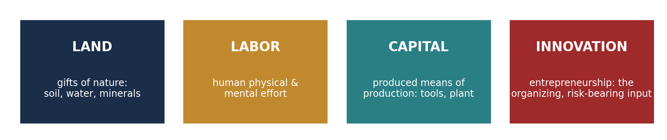
PART 2 · SOCIETY'S SCARCE RESOURCES
The Four Factors of Production
FACTOR | FORMAL DEFINITION | PAYMENT | HISTORICAL EXAMPLE
Land | All natural resources — soil, water, timber, mineral and energy deposits — supplied by nature, not produced. | Rent | Enclosed common fields, England, 1750–1830 (Module 6)
Labor | The physical and mental effort of human beings applied to production; measured in hours and in skill. | Wages | Lancashire mill workers, 1780–1850 (Modules 6 & 8)
Capital | Produced means of production — tools, machines, buildings, infrastructure and financial assets. Unlike land and labor, capital must be created and invested in, and it raises productivity over time. | Interest | Water frame and spinning mule, 1769–1779
Innovation / Entrepreneurship | The organizing, risk-bearing input that combines the other three factors into an enterprise and bears the residual outcome. | Profit | Josiah Wedgwood's division of labor in pottery, 1769
INTRO TO MICROECONOMICS | PROF. VELAZQUEZ
MODULE 1: OVERVIEW OF ECONOMIC THOUGHT AND MODELING

Slide 15
PART 2 · DECISION-MAKING AT THE MARGIN
Marginal Analysis: The Economist's Core Operation
Marginal means EXTRA — it refers to what has changed over a period or with one more unit. Economics' focus on marginality creates a constant need to calculate small units of change. Calculus, and in particular the derivative, is built for exactly this; in this course we will simplify to algebra and ratios.
MB = ΔTotal Benefit
─────────────
ΔQuantity
MC = ΔTotal Cost
──────────
ΔQuantity
Produce / consume
while MB ≥ MC
MARGINAL BENEFIT — the additional gain from one more unit
MARGINAL COST — the additional cost of one more unit
THE GOLDEN RULE — optimum where MB = MC
WHY AT THE MARGIN, NOT IN AGGREGATE?
RATIONAL BEHAVIOR — the assumption
Because decisions are almost never all-or-nothing. You do not choose between studying and not studying; you choose whether to study one more hour. The relevant comparison is therefore always between the benefit and the cost of that ONE additional unit — never between the totals.
Agents respond systematically to incentives and choose the option with the highest net marginal benefit. Formally: an agent expands an activity so long as MB ≥ MC and stops where MB = MC. Rationality here means CONSISTENT, not wise, selfish, or correct.
Helpful brain tip: connect the word EACH with PER and with ONE. "Marginal" is always a per-one-more quantity.
INTRO TO MICROECONOMICS | PROF. VELAZQUEZ
MODULE 1: OVERVIEW OF ECONOMIC THOUGHT AND MODELING

Slide 16
PART 2 · THE CONTESTED ASSUMPTION
Where the Rationality Model Breaks Down
Many economists assume behavior is rational, self-interested and driven by monetary incentives, and that discrete parts of life (education, finance, public policy) can be accurately quantified. Yet research across behavioral, experimental and even classical economics shows the relationship between incentives, choice and financial decision-making is more complex. Money is a powerful motivator — but it operates alongside social norms, identity and intrinsic motivation, particularly where cooperation or altruism are essential.
SCARCITY OF THE MIND
BOUNDED RATIONALITY
MODELS AS MAPS
Mullainathan & Shafir (2013) show that scarcity — of money, time, or resources — captures attention and narrows focus. This "tunneling effect" reduces mental bandwidth, making long-term planning harder and producing choices that look irrational but are rational responses to pressure.
Returns in Modules 2, 8 and 12.
Herbert Simon (1955): people SATISFICE — they accept the first option meeting a minimum threshold — rather than maximize. Cognitive limits, time constraints and incomplete information prevent full optimization.
Preview of Module 12.
This course teaches two kinds of economic thinking. NEOCLASSICAL models (M3–5, M9–11) are powerful maps — among the best we have for understanding how markets coordinate millions of decisions. BEHAVIORAL models (M2, M7, M12) tell us when and why human agents deviate from those maps.
Our job is to know which map to use, and where each one breaks down.
WORKSHEET QUESTION 2 & 3
Give an example from your own experience where your behavior WAS rational at the margin, and one where it was NOT. A cartographer omits trees and fences to make a map legible — what does an economist omit, and what does that tell us about when a model is useful versus misleading?
INTRO TO MICROECONOMICS | PROF. VELAZQUEZ
MODULE 1: OVERVIEW OF ECONOMIC THOUGHT AND MODELING

Slide 17
03
Models as Maps &
the History of Economic Thought
PART
OBJECTIVE Trace economic theory from Classical through Neoclassical to Behavioral and Heterodox traditions; situate each thinker on a human-history timeline.
INTRO TO MICROECONOMICS | PROF. VELAZQUEZ
MODULE 1: OVERVIEW OF ECONOMIC THOUGHT AND MODELING

Slide 18
PART 3 · ORIENTATION
The Course Question & Why History Matters
THE COURSE QUESTION
Why do markets sometimes fail to allocate resources in ways that equitably meet human needs — and what, if anything, should be done about it?
WHY STUDY HISTORY WITH MICROECONOMICS?
WHAT IS AN ECONOMIC MODEL?
Because history supplies the natural experiments economics cannot run in a laboratory. Enclosure, industrialization, famine, war mobilization and financial panic each change one set of conditions while holding much else fixed. History is also the record of which models were believed, by whom, and with what consequences.
A SIMPLIFIED representation of reality that isolates the relationships an economist judges essential, expresses them precisely enough to generate testable predictions, and deliberately omits everything else. A model is judged not by its realism but by the usefulness and accuracy of its predictions.
Though relatively young compared with our long past, economics has developed into a vital field whose tools and frameworks now serve as the foundation for understanding an increasingly quantitative world.
A map that showed every tree and fence would be useless.
The art of economics is knowing what to leave out — and remembering that you left it out.
INTRO TO MICROECONOMICS | PROF. VELAZQUEZ
MODULE 1: OVERVIEW OF ECONOMIC THOUGHT AND MODELING

Slide 19
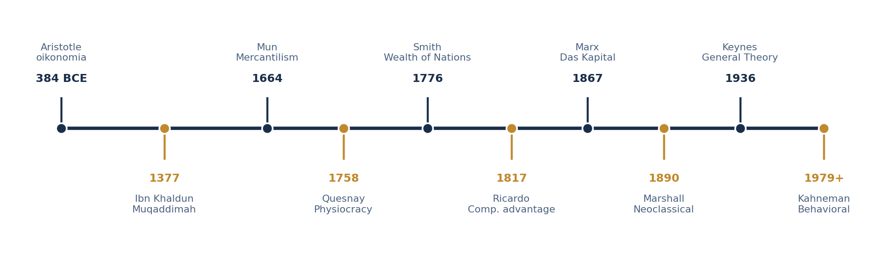
PART 3 · THE LONG VIEW
A Timeline of Economic Thought
ANCIENT & MEDIEVAL
CLASSICAL & NEOCLASSICAL
CRITIQUES & EXPANSIONS
Economics as a branch of moral philosophy: the just purposes of exchange, the ethics of usury, the rise and fall of states.
1776–1890. Markets as coordinating systems; then the Marginal Revolution formalizes them with calculus and geometry.
1867–present. Class, institutions, uncertainty, cognition, capability and the commons — where the neoclassical map runs out.
INTRO TO MICROECONOMICS | PROF. VELAZQUEZ
MODULE 1: OVERVIEW OF ECONOMIC THOUGHT AND MODELING

Slide 20
PART 3 · THE POWER OF BEING A "RATIONAL" BEING
Classical & Neoclassical Theorists
While the history of economic thought has ancient roots, many mark 1776 as the start of classical economics and Western economic thought, because of the release of Adam Smith's Wealth of Nations — which laid the groundwork for capitalist economic systems. Following Newton's development of calculus, the Marginal Revolution of the late 19th century — Jevons, Menger, Walras — formalized these earlier ideas, culminating in neoclassical economics in 1890 with Alfred Marshall's Principles of Economics.
YEAR | THINKER & WORK | CORE CONTRIBUTION
1776 | Adam Smith — The Wealth of Nations | Self-interest and the "invisible hand" guide markets to socially beneficial outcomes without central coordination; the division of labor drives productivity growth (the pin factory).
1789 | Jeremy Bentham — Principles of Morals and Legislation | Utilitarianism: individuals act to maximize pleasure and minimize pain. The origin of the utility function.
1798 | Thomas Malthus — Essay on the Principle of Population | Population grows geometrically while food supply grows arithmetically; diminishing returns to land. Returns in Module 7.
1803 | Jean-Baptiste Say — Treatise on Political Economy | Say's Law: supply creates its own demand.
1817 | David Ricardo — Principles of Political Economy and Taxation | Comparative advantage: both parties gain from trade when each specializes where opportunity cost is lowest. Also the theory of economic rent. ← PART 6 TODAY
1861 | John Stuart Mill — Utilitarianism | Refined utilitarianism; distinguished higher from lower pleasures; social welfare matters.
1871 | Jevons & Menger — marginal utility | Marginal utility theory and the subjectivist theory of value; launched the Marginal Revolution.
1874 | Léon Walras — Elements of Pure Economics | General equilibrium theory; formalized markets mathematically.
1890 | Alfred Marshall — Principles of Economics | Synthesized classical economics with calculus and geometry: the supply-and-demand diagram, consumer surplus, elasticity and partial equilibrium — the toolkit of Modules 3–5.
1906 | Vilfredo Pareto — Manual of Political Economy | Pareto efficiency; distribution and welfare theory. Returns in Modules 5 and 11.
INTRO TO MICROECONOMICS | PROF. VELAZQUEZ
MODULE 1: OVERVIEW OF ECONOMIC THOUGHT AND MODELING

Slide 21
PART 3 · HETERODOX AND EMERGING ECONOMICS
Critiques & Expansions — "Heterodox" Thought
These scholars are in no way "irrational" within their own work — the term emphasizes how they challenge and extend neoclassical thought.
YEAR | THINKER & WORK | CORE CONTRIBUTION
1867 | Karl Marx — Das Kapital, Vol. I | Theory of surplus value: capitalism generates profit by paying workers less than the full value of their labor. Predicted overproduction, falling profit rates and class conflict.
1899 | Thorstein Veblen — The Theory of the Leisure Class | "Conspicuous consumption": consumption is driven by social status, not utility maximization. Founded institutionalism.
1936 | John Maynard Keynes — The General Theory | Markets can stick at high-unemployment equilibrium; fiscal policy can restore full employment; "animal spirits" drive volatile investment.
1942 | Joseph Schumpeter — Capitalism, Socialism and Democracy | "Creative destruction": entrepreneurs disrupt and replace existing industries; innovation, not static equilibrium, is the engine of growth.
1944 | Friedrich Hayek — The Road to Serfdom | The knowledge problem: prices aggregate dispersed local knowledge no central authority could collect. Spontaneous order outperforms designed allocation.
1947 | Herbert Simon — Administrative Behavior | Bounded rationality: people satisfice rather than optimize, given cognitive limits, time constraints and incomplete information.
1963 | Milton Friedman — A Monetary History of the U.S. | Inflation is always and everywhere a monetary phenomenon; a constant money-growth rule; revived classical liberalism.
1950s | John Nash — Non-Cooperative Games | Every finite game has at least one equilibrium in which no player gains by changing strategy unilaterally. Foundation of Module 11.
1970 | George Akerlof — The Market for Lemons | Asymmetric information causes market failure. Foundation of Modules 8 and 12.
1979 | Kahneman & Tversky — Prospect Theory | People evaluate outcomes against a reference point and weigh losses roughly twice as heavily as equivalent gains; systematic violations of expected utility.
1990 | North · Ostrom | Institutions shape long-run development (North). Communities sustainably self-govern common-pool resources without privatization or state mandate (Ostrom, Nobel 2009).
1999+ | Sen · Thaler & Sunstein · Banerjee & Duflo · Piketty | Capabilities, not income, measure development (Sen). Choice architecture improves decisions without restricting freedom (Nudge, 2008). RCTs bring experimental rigor to poverty policy. r > g: wealth grows faster than income, so capitalism trends toward inequality (Piketty, 2013).
INTRO TO MICROECONOMICS | PROF. VELAZQUEZ
MODULE 1: OVERVIEW OF ECONOMIC THOUGHT AND MODELING

Slide 22
PART 3 · MATH IS THE FIRST LANGUAGE OF ECONOMICS
The Scope of Mathematical Reasoning in Economics
LEVEL OF REASONING | TYPICAL AGE | WHAT IT LETS AN ECONOMIST DO
Operational & Fractional Reasoning | 5 – 10 | Basic operations, multiplicative reasoning, decimals and fractions.
Proportional Reasoning | 10 – 14 | Rates, ratios, and graphing simple relationships in the coordinate plane. ← ELASTICITY, MODULE 4
Algebraic Reasoning | 11 – 16 | Solving and graphing functions and equations. ← BUDGET CONSTRAINT & MARKET MODEL, MODULES 1 & 3
Calculus — Marginal Reasoning | 16 – 20 | Solving complex functions; differentiation and integration. This is TRUE marginal (economic) thought. ← MR = MC, MODULES 9–11
Statistical & Applied Reasoning | 18 – 22 | Often includes linear algebra; given statistical software this area has become less theoretical and more technical, centered on big-data coding solutions.
WHAT THIS MEANS FOR YOU
We will simplify mathematical expressions wherever possible, focusing on algebra and ratios to support internalization of the concepts. Where calculus is the true tool, we will name it — and then compute the same answer with a slope.
Think of the first economists physically calculating and writing in the MARGINS of old accounting books.
That is where the word comes from — but the real instrument was calculus.
INTRO TO MICROECONOMICS | PROF. VELAZQUEZ
MODULE 1: OVERVIEW OF ECONOMIC THOUGHT AND MODELING

Slide 23
YOU TRY
Section I — Check for Understanding
Complete PART 1, PART 2 and PART 3 of the Module 1 Worksheet.
Pay particular attention to the thinker-matching exercise on pages 4–6 — twenty thinkers, twenty contributions, each used exactly once.
Then answer reflection questions ✦2 and ✦3 in complete sentences.
If you finish early: begin defining the Part 4 vocabulary — budget constraint, feasible set, slope.
15
MIN
INTRO TO MICROECONOMICS | PROF. VELAZQUEZ

Slide 24
SECTION II
Economic Modeling
Part 4 · Build the budget constraint — table → equation → graph; calculate opportunity cost; apply feasibility rules
Part 5 · Build the production possibilities model; explain the law of increasing opportunity cost
Part 6 · Use the PPM of two producers to explain comparative advantage and the gains from trade

Slide 25
04
Model a Consumer:
The Budget Constraint
PART
OBJECTIVE Build the budget constraint from a table, derive its equation, graph it, and analyze the effect of a price shock.
INTRO TO MICROECONOMICS | PROF. VELAZQUEZ
MODULE 1: OVERVIEW OF ECONOMIC THOUGHT AND MODELING

Slide 26
PART 4 · LIMITED INCOME, UNLIMITED DESIRES
The Budget Constraint — Conceptual Narrative
LEADING QUESTION
How does a consumer with limited income make a choice between two goods?
If a consumer has limited income and a choice between two goods, the total amount spent cannot exceed income. As a result there are set pairings — CONSUMPTION BUNDLES — that the individual can afford. Based on individual preference, or the utility function over these goods, the person selects a combination. The budget constraint tells us what is POSSIBLE; preferences (Module 2) tell us which possibility is CHOSEN.
I = Px · X + Py · Y
Y = I/Py − (Px/Py) · X
GENERAL FORM — income exactly exhausted on two goods
SLOPE-INTERCEPT FORM — solve for the vertical-axis good
THE VERTICAL INTERCEPT
THE HORIZONTAL INTERCEPT
THE SLOPE = −Px / Py
I / Py. The maximum quantity of good Y obtainable if the entire income is devoted to Y. Set X = 0.
I / Px. The maximum quantity of good X obtainable if the entire income is devoted to X. Set Y = 0.
The negative ratio of prices. This is the OPPORTUNITY COST of one more unit of X, measured in units of Y. It is the market's exchange rate between the two goods.
INTRO TO MICROECONOMICS | PROF. VELAZQUEZ
MODULE 1: OVERVIEW OF ECONOMIC THOUGHT AND MODELING

Slide 27
PART 4 · RULES OF THUMB
Reading the Budget Line
1
INSIDE the line
2
ON the line
3
OUTSIDE the line
FEASIBLE but INEFFICIENT. The bundle is affordable, but income is left unspent — the consumer could have more of at least one good at no cost in the other.
FEASIBLE and EFFICIENT. Income is exactly exhausted. Every bundle on the line satisfies I = PxX + PyY. Optimal choice must lie here.
NOT FEASIBLE — unattainable at current income and prices. Reaching it requires higher income or lower prices.
CHANGE | EFFECT ON THE LINE | ECONOMIC MEANING
Income rises | PARALLEL shift OUTWARD (right) | Both intercepts rise proportionally; the relative price — the slope — is unchanged.
Income falls | PARALLEL shift INWARD (left) | Both intercepts fall proportionally; the slope is unchanged.
Price of X rises | ROTATION inward around the Y-intercept | The Y-intercept is ANCHORED (Py unchanged), the X-intercept falls, the line steepens.
Price of Y rises | ROTATION inward around the X-intercept | The X-intercept is anchored, the Y-intercept falls, the line flattens.
WORKSHEET ✦ 4 · AND ONE MORE RULE
When the price of iron tools rises, the budget constraint ROTATES — it does not shift in parallel. Explain geometrically and intuitively why one intercept is anchored while the other changes. NOTE: if all prices AND income rise by the same percentage, the budget set does not change at all — money illusion is ruled out.
INTRO TO MICROECONOMICS | PROF. VELAZQUEZ
MODULE 1: OVERVIEW OF ECONOMIC THOUGHT AND MODELING

Slide 28
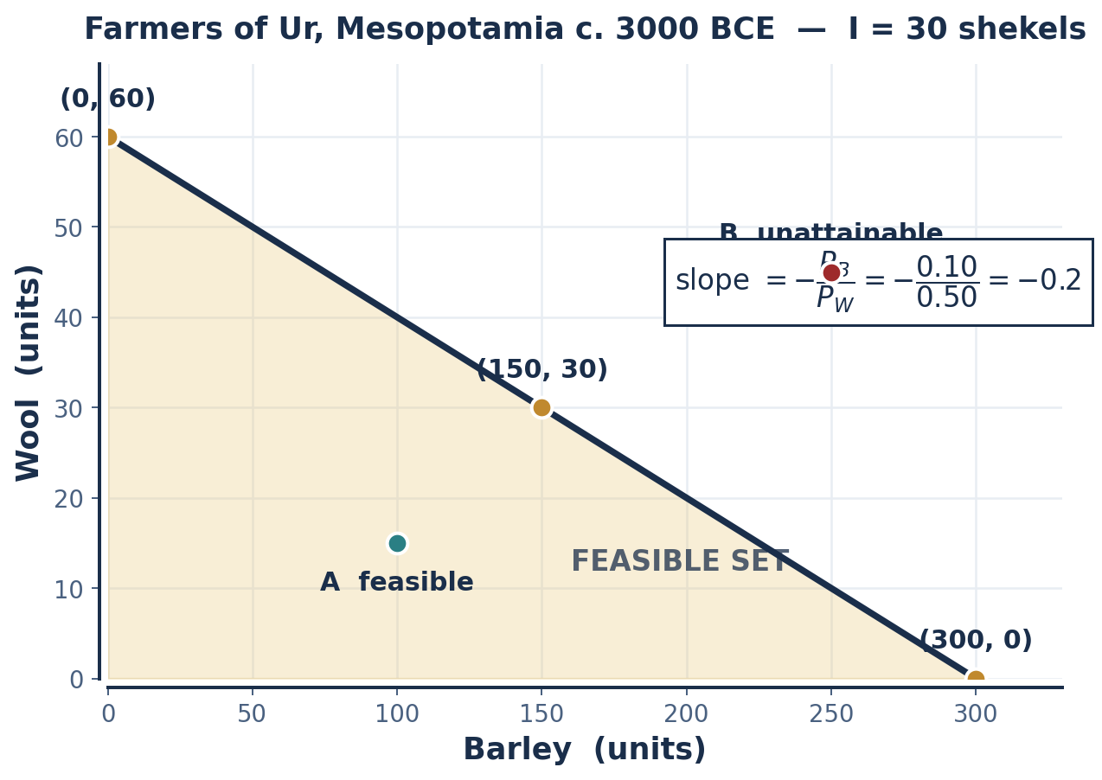
SCENARIO 1.1 · MESOPOTAMIA, C. 3000 BCE
The Farmers of Ur
You are a farmer in Mesopotamia around 3000 BCE. You receive 30 shekels of silver each month from selling dates at market. You can spend this income on two goods: barley (food and seed) — 1 shekel buys 10 units — and wool (for clothing and trade) — 1 shekel buys 2 units.
PB = 1/10 = 0.10 shekel PW = 1/2 = 0.50 shekel
Price per unit = shekels ÷ units obtained per shekel
INCOME (shekels) | BARLEY (units) | WOOL (units) | CHECK: 0.10B + 0.50W
30 | 0 | 60 | 0 + 30 = 30 ✓
30 | 50 | 50 | 5 + 25 = 30 ✓
30 | 100 | 40 | 10 + 20 = 30 ✓
30 | 150 | 30 | 15 + 15 = 30 ✓
30 | 300 | 0 | 30 + 0 = 30 ✓
TRADE-OFF
For every 1 unit of WOOL the farmer must give up 5 units of BARLEY. Opportunity cost is ALWAYS expressed in terms of the other good.
INTRO TO MICROECONOMICS | PROF. VELAZQUEZ
MODULE 1: OVERVIEW OF ECONOMIC THOUGHT AND MODELING

Slide 29
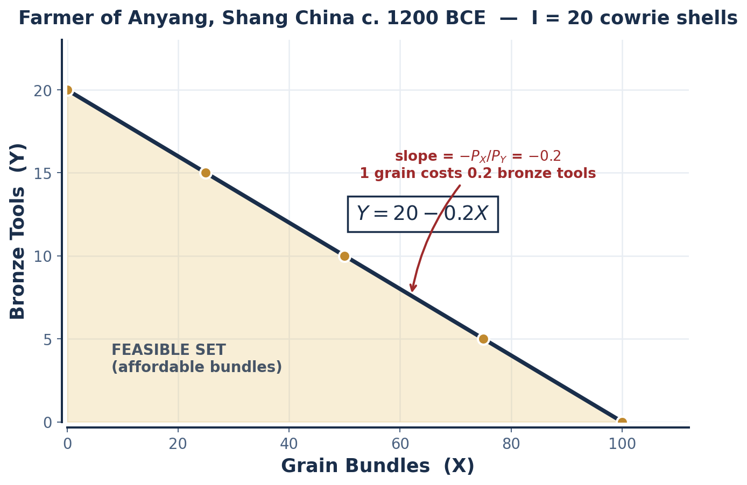
SCENARIO 1.2 · SHANG CHINA, C. 1200 BCE
The Farmer of Anyang
A peasant farmer in Anyang during the late Shang Dynasty has 20 cowrie shells. At market he can buy grain for winter storage or bronze for repairing sickle blades. 1 cowrie shell = 5 units of grain; 1 cowrie shell = 1 unit of bronze.
GRAIN BUNDLES (X) | BRONZE TOOLS (Y) | TOTAL COST (shells) | FEASIBLE?
100 | 0 | 20 + 0 = 20 | Yes — on the line
75 | 5 | 15 + 5 = 20 | Yes — on the line
50 | 10 | 10 + 10 = 20 | Yes — on the line
25 | 15 | 5 + 15 = 20 | Yes — on the line
0 | 20 | 0 + 20 = 20 | Yes — on the line
50 | 5 | 10 + 5 = 15 | INSIDE (5 unspent)
100 | 10 | 20 + 10 = 30 | OUTSIDE — not feasible
20 = 0.2X + 1.0Y → Y = 20 − 0.2X
Note the price computation: P_grain = 1 shell ÷ 5 units = 0.2 shells per unit. P_bronze = 1 shell ÷ 1 unit = 1.0 shell per unit.
Slope = −Px/Py = −0.2: one more grain bundle costs 0.2 bronze tools.
X-intercept = 20/0.2 = 100 grain. Y-intercept = 20/1.0 = 20 tools.
INTRO TO MICROECONOMICS | PROF. VELAZQUEZ
MODULE 1: OVERVIEW OF ECONOMIC THOUGHT AND MODELING

Slide 30
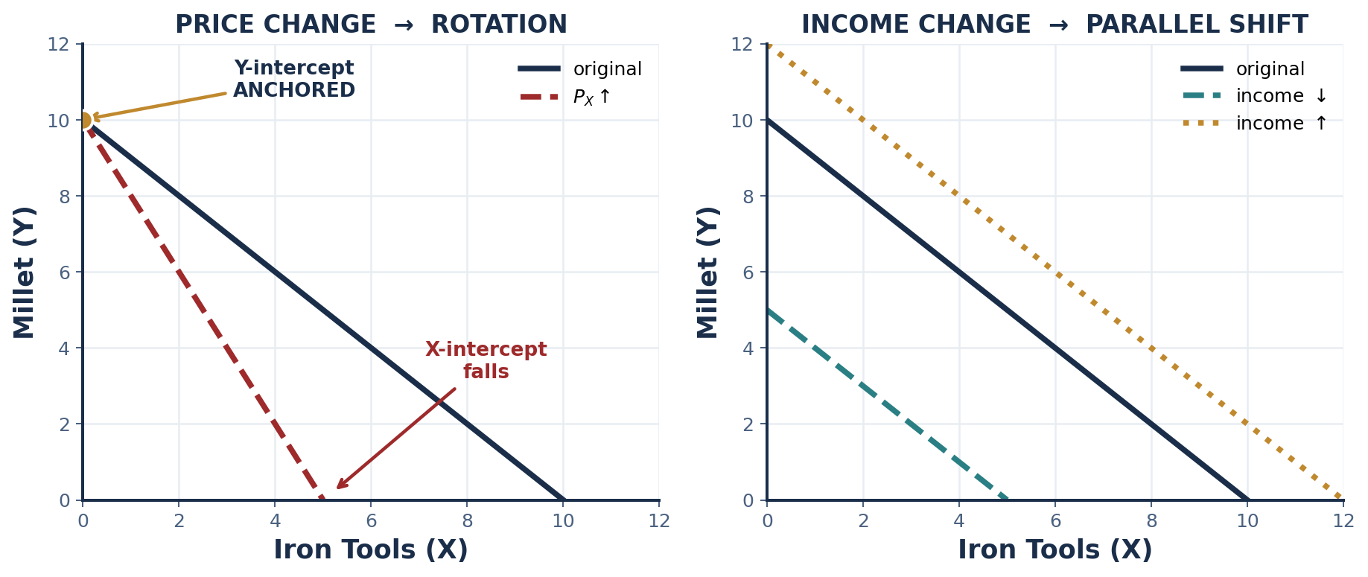
SCENARIO 1.3 · UPPER NIGER, C. 1000 BCE
The Herder Faro — and the Price Shock
In the Upper Niger around 1000 BCE a herder named Faro arrives at a bustling market carrying 10 gold-dust rings, the product of trading calves and milk. Millet is life: 1 ring buys 4 sacks, enough to feed his household and store in the village granary for the dry season. But iron tools are power: 1 ring buys a sickle or spearhead forged by blacksmiths, whose craft was already shaping West African societies. Faro must decide — secure food for his family, or invest in the tools that protect his cattle and his future?
QUESTION | ANSWER
All 10 rings on millet? | 10 × 4 = 40 sacks of millet, 0 iron tools
All 10 rings on iron tools? | 10 × 1 = 10 iron tools, 0 sacks of millet
Price of millet | 1 ÷ 4 = 0.25 rings per sack
Price of iron tools | 1 ÷ 1 = 1.0 ring per tool
Slope (OC of 1 tool) | −P_tool/P_millet = −1.0/0.25 = −4 sacks
The trade-off | Each additional iron tool costs Faro 4 sacks of millet — roughly a month of household food.
✦4 WHY A ROTATION, NOT A SHIFT
GEOMETRICALLY: a change in Px alters the X-intercept (I/Px) but leaves the Y-intercept (I/Py) untouched, because the Y-intercept contains no Px term. The line therefore pivots about the anchored intercept.
INTUITIVELY: if you were spending everything on Y, a change in the price of X cannot affect what you can afford. It only bites once you buy some X — and it bites harder the more X you buy.
INTRO TO MICROECONOMICS | PROF. VELAZQUEZ
MODULE 1: OVERVIEW OF ECONOMIC THOUGHT AND MODELING

Slide 31
05
Model a Producer:
The Production Possibilities Model
PART
OBJECTIVE Build the PPM; explain the law of increasing opportunity cost; distinguish efficient, inefficient and unattainable points.
INTRO TO MICROECONOMICS | PROF. VELAZQUEZ
MODULE 1: OVERVIEW OF ECONOMIC THOUGHT AND MODELING

Slide 32
PART 5 · LIMITED RESOURCES | LIMITED TECHNOLOGY | UNLIMITED DESIRES
The Production Possibilities Model — Conceptual Narrative
LEADING QUESTION
How does a producer with limited resources and fixed technology make a choice between producing two goods?
If a producer has limited labor and technology and is choosing between two goods, they face a downward-sloping, CURVED production possibilities curve. This is because as they want more of a good, the opportunity cost — expressed in terms of the other good — is increasing, causing an increasing slope along the curve.
POINTS ON THE CURVE
POINTS INSIDE THE CURVE
POINTS OUTSIDE THE CURVE
EFFICIENT and ATTAINABLE. All resources are fully and best employed. Producing more of one good necessarily requires producing less of the other.
ATTAINABLE but INEFFICIENT. Resources are unemployed or misallocated — an economy in recession, idle capital, or underused labor. More of BOTH goods is possible.
UNATTAINABLE with current resources and technology. Reaching them requires economic GROWTH: new resources, better technology, or a larger labor force.
LAW OF INCREASING OPPORTUNITY COST
The more you want of good X, the more and more of good Y you must give up — and vice versa.
ALLEGORY: the mountain gets steeper as you climb, so you must give up more weight to keep going.
INTRO TO MICROECONOMICS | PROF. VELAZQUEZ
MODULE 1: OVERVIEW OF ECONOMIC THOUGHT AND MODELING

Slide 33
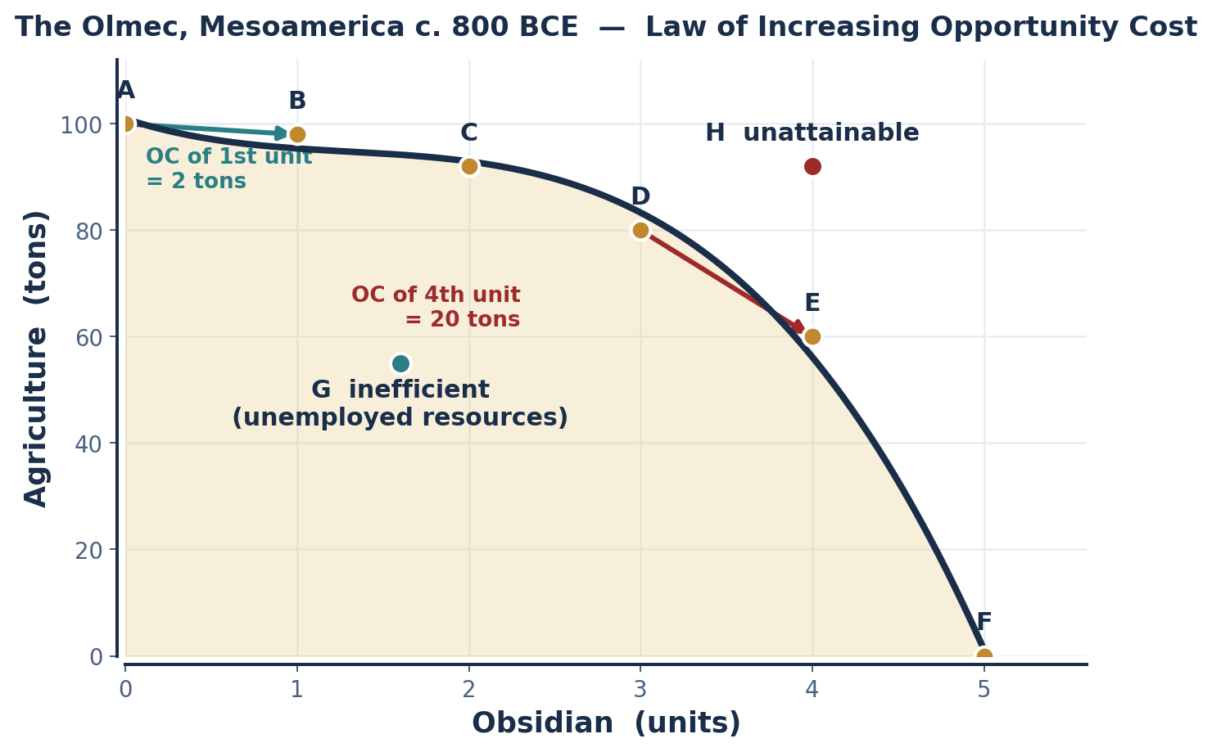
SCENARIO 1.4 · MESOAMERICA, C. 800 BCE
The People of Olmec — Deriving Opportunity Cost
The Olmecs made strategic production decisions between agriculture (food) and obsidian, a volcanic glass used for tools and trade. With fixed land, labor and technology, each unit of obsidian required diverting resources from agriculture.
POINT | OBSIDIAN | AGRICULTURE | OC OF 1 MORE OBSIDIAN | OC OF 1 MORE AGR.
A | 0 | 100 | — | —
B | 1 | 98 | 2 tons | 0.50 obsidian
C | 2 | 92 | 6 tons | 0.17 obsidian
D | 3 | 80 | 12 tons | 0.08 obsidian
E | 4 | 60 | 20 tons | 0.05 obsidian
F | 5 | 0 | 60 tons | 0.017 obsidian
WHERE THE MATH LIVES
LOOK TO THE MARGINS OF THE TABLE. Opportunity cost is the vertical change ÷ the horizontal change between adjacent rows — the slope. OC of obsidian rises 2 → 6 → 12 → 20 → 60. That rise IS the law of increasing opportunity cost, and it is why the curve bows outward.
✦5 Why does the PPM bow outward rather than appear as a straight line? Because resources are NOT perfectly adaptable between uses — the land and labor best suited to obsidian are drawn in first, and each further unit must draw on resources progressively better suited to agriculture.
INTRO TO MICROECONOMICS | PROF. VELAZQUEZ
MODULE 1: OVERVIEW OF ECONOMIC THOUGHT AND MODELING

Slide 34
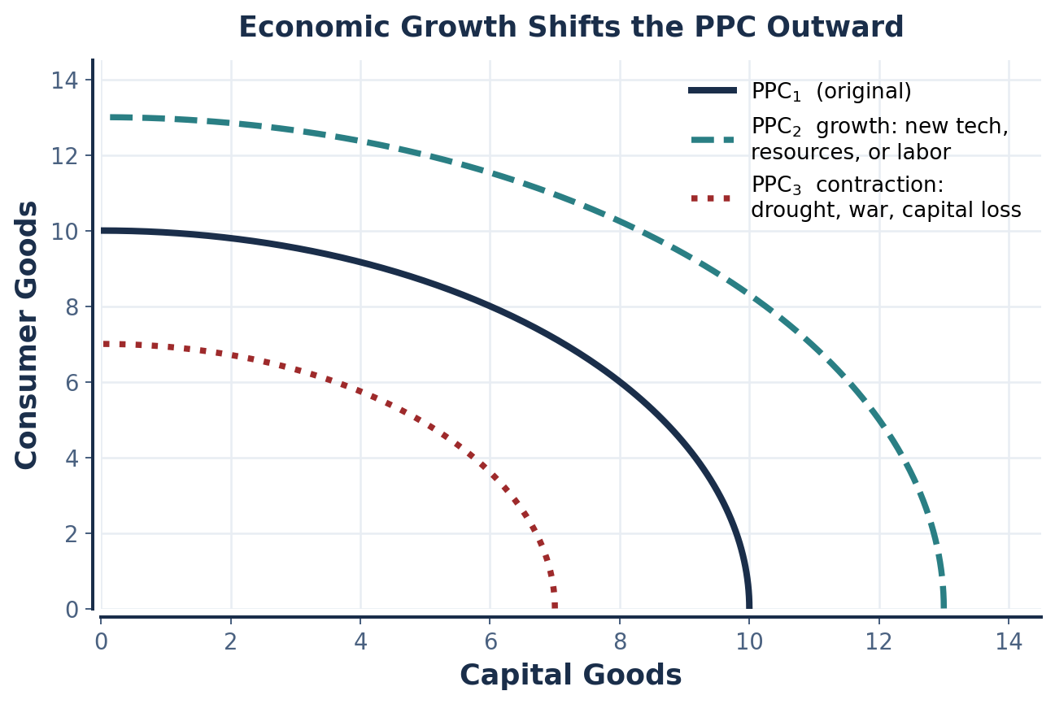
PART 5 · ECONOMIC GROWTH
Shifting the Production Possibilities Curve
SHIFTS OUTWARD WHEN…
(1) New resources are discovered or acquired — land, mineral deposits, water.
(2) Technology improves — the same inputs yield more output.
(3) The labor force grows, in size or in human capital.
(4) Capital accumulates through investment.
SHIFTS INWARD WHEN…
Resources are destroyed or lost: drought destroying farmland, war, epidemic, capital depreciation without replacement. Worksheet: a drought destroys 20% of Olmec farmland — show it.
CAREFUL — A DISTINCTION WE WILL REUSE
MOVING ALONG the curve is reallocation. SHIFTING the curve is growth. Confusing the two is the single most common error on Module 1 assessments.
INTRO TO MICROECONOMICS | PROF. VELAZQUEZ
MODULE 1: OVERVIEW OF ECONOMIC THOUGHT AND MODELING

Slide 35
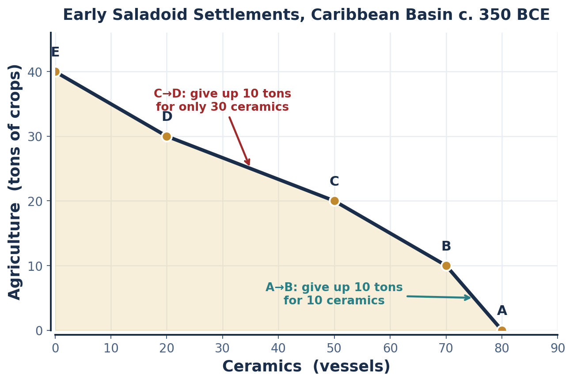
SCENARIO 1.5 · CARIBBEAN BASIN, C. 350 BCE
Early Saladoid Settlements
The early Saladoid culture made production decisions between agriculture (food crops) and ceramics (pottery for trade and storage). Their ceramic tradition was remarkable for its quality — but every hour spent on pottery was an hour away from farming.
POINT | CERAMICS | AGRICULTURE | ΔAGR PER 10 CERAMICS
A | 80 | 0 | —
B | 70 | 10 | 10 tons
C | 50 | 20 | 5 tons
D | 20 | 30 | 3.3 tons
E | 0 | 40 | 5 tons
READ THE TABLE IN THE OTHER DIRECTION
A → B: 10 more ceramics costs 10 tons of agriculture.
C → D: moving from C to D gains 10 tons of agriculture but costs 30 ceramics.
Ask the worksheet's question precisely: as the Saladoid produce MORE CERAMICS (moving E → A), does each additional ceramic cost more or less agriculture? Track the direction of travel before you compute.
INTRO TO MICROECONOMICS | PROF. VELAZQUEZ
MODULE 1: OVERVIEW OF ECONOMIC THOUGHT AND MODELING

Slide 36
06
Model Two Producers:
Comparative Advantage & Trade
PART
OBJECTIVE Use PPM data to calculate opportunity costs, identify comparative advantage, and demonstrate that both parties gain from specialization and trade.
INTRO TO MICROECONOMICS | PROF. VELAZQUEZ
MODULE 1: OVERVIEW OF ECONOMIC THOUGHT AND MODELING

Slide 37
PART 6 · LIMITED RESOURCES | LIMITED TECHNOLOGY | UNLIMITED DESIRES
Comparative Advantage — Conceptual Narrative
LEADING QUESTION
How does a producer choose between two goods when they have the option to specialize in one and trade for the other?
If two producers make a good and trade is possible, we must look to their OPPORTUNITY COSTS to understand who should produce what. The key: the producer with the lower opportunity cost — not merely the one who makes the most — should specialize in that good and trade for the other. Focus your work on the goods that require you to give up the least, and trade for the rest. This creates an overall GAIN FROM TRADE, where total output has increased globally.
ABSOLUTE ADVANTAGE
COMPARATIVE ADVANTAGE
The ability to produce a GREATER QUANTITY of a good using the same quantity of resources — or the same quantity using fewer resources. It is a statement about productivity.
GRAPHICALLY: whose intercept is higher on that good's axis?
The ability to produce a good at a LOWER OPPORTUNITY COST than another producer. It is a statement about trade-offs, not productivity.
GRAPHICALLY: whose PPC is FLATTER in that good? Compare slopes, not heights.
OC of 1 unit of X = (units of Y given up) ÷ (units of X gained)
RULE OF THUMB: specialize where your opportunity cost is LOWER. Ricardo (1817) proved that two parties both gain from trade
when each specializes where opportunity cost is lowest — EVEN IF one party is absolutely more productive at everything.
INTRO TO MICROECONOMICS | PROF. VELAZQUEZ
MODULE 1: OVERVIEW OF ECONOMIC THOUGHT AND MODELING

Slide 38
SCENARIO 1.6 · C. 200 BCE
Maurya India & Hellenistic Greece
Merchants in Hellenistic Greece craved spices and textiles, while the courts of Maurya India prized silver and luxury goods. Both civilizations had workers who could produce either category, but productivity differed. In one day a GREEK worker can produce either 6 units of silver goods OR 3 units of spices. An INDIAN worker can produce either 4 units of silver goods OR 8 units of spices.
PRODUCER (10 workers) | MAX SILVER GOODS | MAX SPICES | OC OF 1 SPICE (in silver) | OC OF 1 SILVER (in spices)
India | 40 (10 × 4) | 80 (10 × 8) | 40/80 = 0.5 silver ← LOWER | 80/40 = 2.0 spices
Greece | 60 (10 × 6) | 30 (10 × 3) | 60/30 = 2.0 silver | 30/60 = 0.5 spices ← LOWER
COMPARATIVE ADVANTAGE
ABSOLUTE ADVANTAGE
TERMS OF TRADE
SILVER GOODS: Greece (60 > 40).
SPICES: India (80 > 30).
Here each holds one — so comparative and absolute advantage happen to coincide.
INDIA in SPICES (0.5 < 2.0).
GREECE in SILVER GOODS (0.5 < 2.0).
Any price between 0.5 and 2.0 silver per spice benefits BOTH. Outside that band, one party does better producing for itself.
THE WORKSHEET TABLE USES PER-WORKER FIGURES
The worksheet lists India 60/120 and Greece 40/40 — different totals, identical opportunity-cost ratios. Comparative advantage depends only on the RATIO, never on the scale of the economy.
INTRO TO MICROECONOMICS | PROF. VELAZQUEZ
MODULE 1: OVERVIEW OF ECONOMIC THOUGHT AND MODELING

Slide 39
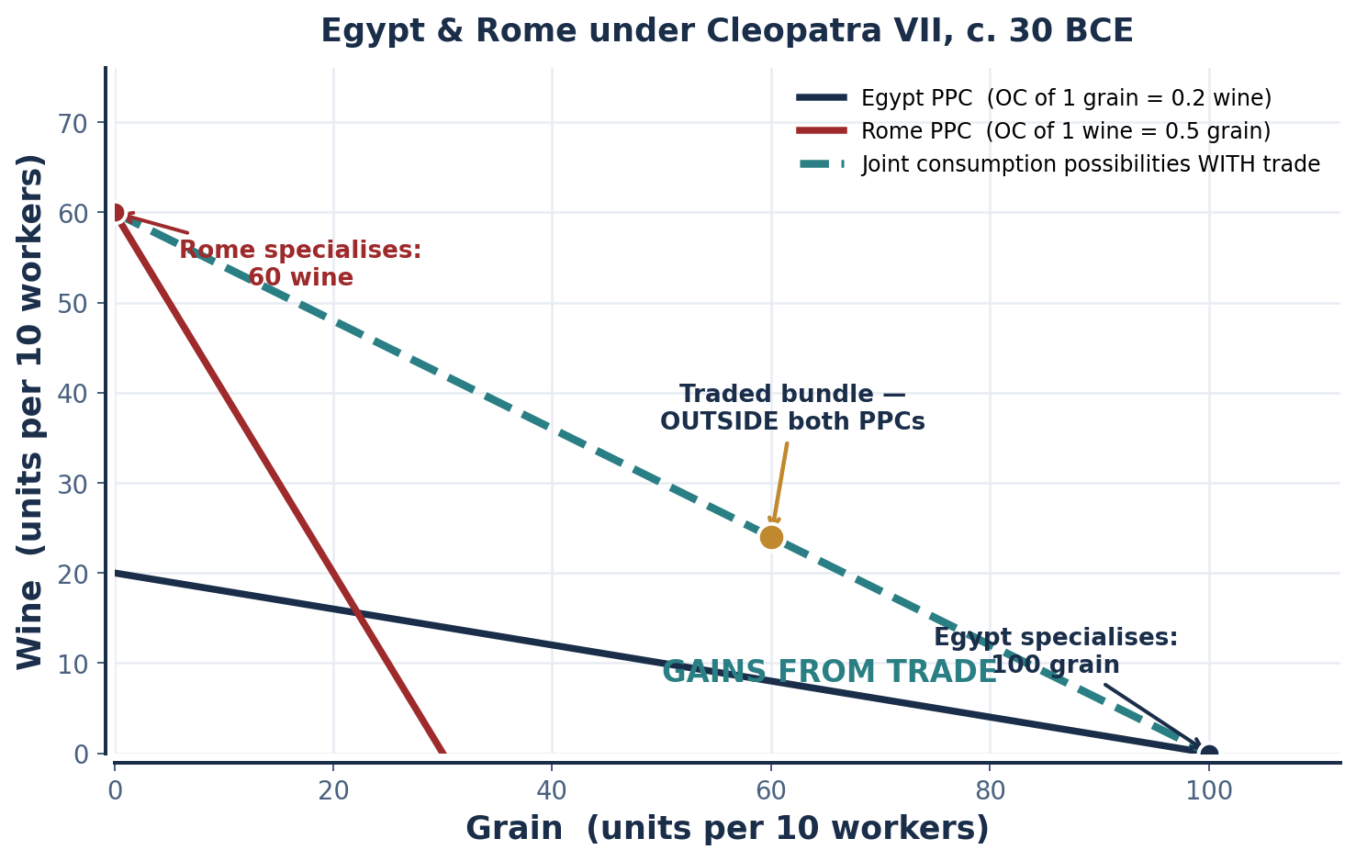
SCENARIO 1.7 · C. 30 BCE
Egypt & Rome under Cleopatra VII
Cleopatra VII commanded a civilization rich in grain and papyrus, entangled politically and economically with Rome, which was rich in military power and wine. In one day an EGYPTIAN worker produces either 10 grain OR 2 wine; a ROMAN worker produces either 3 grain OR 6 wine.
 | GRAIN / DAY | WINE / DAY | OC OF 1 GRAIN | OC OF 1 WINE
Egypt | 10 | 2 | 0.2 wine ← LOWER | 5.0 grain
Rome | 3 | 6 | 2.0 wine | 0.5 grain ← LOWER
EFFICIENT SPECIALIZATION
EGYPT produces GRAIN — its OC of grain (0.2 wine) is below Rome's (2.0 wine).
ROME produces WINE — its OC of wine (0.5 grain) is below Egypt's (5.0 grain).
NOTE ON ABSOLUTE ADVANTAGE
THE GAIN FROM TRADE
Egypt is absolutely better at grain; Rome absolutely better at wine. Change the numbers so Egypt is better at BOTH and the specialization pattern does not change — only the ratios matter.
After specialization and trade, BOTH parties can consume OUTSIDE their individual PPC. The dashed joint line lies above both — that region is the gain.
INTRO TO MICROECONOMICS | PROF. VELAZQUEZ
MODULE 1: OVERVIEW OF ECONOMIC THOUGHT AND MODELING

Slide 40
PART 6 · SYNTHESIS
Trade, Leverage & the Limits of the Model
💡 WORKSHEET QUESTION 7 — SYNTHESIS
Cleopatra understood that Egypt's grain surplus gave her leverage over Rome's food security. Using comparative advantage AND the budget constraint: (a) why did Egypt have an incentive to trade even though it could produce wine? (b) how could Cleopatra use comparative advantage as political leverage? Does comparative advantage always lead to mutually beneficial trade in the real world?
a
WHY TRADE ANYWAY
b
SPECIALIZATION AS LEVERAGE
c
WHERE THE MODEL BREAKS
Egypt COULD produce wine, but only by giving up 5 units of grain per unit of wine. Buying wine from Rome at any rate below 5 grain leaves Egypt with more of both. Capability is not the question — opportunity cost is.
Specialization creates DEPENDENCE. Rome's specialization in wine made its food supply contingent on Egyptian grain. The gains from trade are real — but so is the bargaining power they concentrate in whoever supplies the necessity.
The model assumes no transport costs, no transition costs for displaced workers, full employment, constant returns, and that the GAINS are actually shared. Each assumption fails somewhere — and each failure is a later module.
PREVIEW — THE NARRATIVE THREAD
In Module 2 you will meet Marcus and Ray. Their economic relationship — wages, rents, gains, constraints — mirrors the structure of comparative advantage. Ask yourself as the course unfolds: WHO SPECIALIZES, AND WHO CAPTURES THE GAINS? That question is the spine of Modules 6, 7 and 8.
INTRO TO MICROECONOMICS | PROF. VELAZQUEZ
MODULE 1: OVERVIEW OF ECONOMIC THOUGHT AND MODELING

Slide 41
YOU TRY
Section II — Independent Practice
Complete PARTS 4, 5 and 6 of the Module 1 Worksheet, including all graphs — axes, intercepts, slope and feasible region fully labeled.
Khan Academy: Basic Economic Concepts Quiz 1 and Quiz 2 — reach mastery.
Khan Academy: Basic Economic Concepts Quiz 3 — focus on cost-benefit analysis; exposure is all that is required.
HEADS UP: Utility appears in Quiz 3 but is not covered in class until Module 2. Try the questions as exposure.
HOMEWORK RULE OF THUMB: above 80% → move on. Below 80% → retry once or twice. Consistently below 80% → office hours, immediately.
20
MIN
INTRO TO MICROECONOMICS | PROF. VELAZQUEZ

Slide 42
MODULE 1
What You Should Be Able to Do
 | LEARNING OUTCOME
Part 1 | State the scientific method as applied in economics; classify any statement as positive or normative; define ceteris paribus, natural experiment, micro, macro, short-run and long-run.
Part 2 | Define scarcity, choice and opportunity cost formally; name and define the four factors of production and their factor payments; compute marginal benefit and marginal cost and apply the MB ≥ MC decision rule.
Part 3 | Place at least twelve thinkers in their school and century, and state each one's core contribution; explain the 'models as maps' framing and name one neoclassical assumption worth scrutiny.
Part 4 | Build a budget constraint from a price-and-income scenario in all three forms; compute both intercepts and the slope; classify any bundle as inside, on, or outside; distinguish rotation from parallel shift.
Part 5 | Build a PPM from tabular data; compute opportunity cost between adjacent points; explain why the curve bows outward; classify points as efficient, inefficient or unattainable; distinguish movement along from shifts of the curve.
Part 6 | Compute opportunity costs for two producers; identify absolute and comparative advantage; determine the efficient specialization pattern and the range of mutually beneficial terms of trade; show the gains from trade graphically.
NEXT
MODULE 2 — CHOICE. Utility, indifference curves, and the optimal consumption bundle: where the budget constraint meets preference.
INTRO TO MICROECONOMICS | PROF. VELAZQUEZ
MODULE 1: OVERVIEW OF ECONOMIC THOUGHT AND MODELING

Slide 43
MODULE 1
References
Akerlof, G. A. (1970). The market for lemons: Quality uncertainty and the market mechanism. Quarterly Journal of Economics, 84(3), 488–500.
Becker, G. S. (1976). The economic approach to human behavior. University of Chicago Press.
Bentham, J. (1789). An introduction to the principles of morals and legislation. Oxford: Clarendon Press.
Duflo, E., & Banerjee, A. (2011). Poor economics: A radical rethinking of the way to fight global poverty. PublicAffairs.
Kahneman, D., & Tversky, A. (1979). Prospect theory: An analysis of decision under risk. Econometrica, 47(2), 263–292.
Khaldun, I. (1377/1958). The Muqaddimah: An introduction to history (F. Rosenthal, Trans.). Princeton University Press.
Malthus, T. R. (1798). An essay on the principle of population. London: J. Johnson.
Marshall, A. (1890). Principles of economics. London: Macmillan.
Mullainathan, S., & Shafir, E. (2013). Scarcity: Why having too little means so much. Times Books.
North, D. C. (1990). Institutions, institutional change, and economic performance. Cambridge University Press.
Ostrom, E. (1990). Governing the commons: The evolution of institutions for collective action. Cambridge University Press.
Piketty, T. (2013). Capital in the twenty-first century. Paris: Seuil. (English ed., 2014, Harvard University Press).
Quesnay, F. (1758). Tableau économique. Versailles.
Ricardo, D. (1817). On the principles of political economy and taxation. London: John Murray.
Schumpeter, J. A. (1942). Capitalism, socialism and democracy. Harper & Brothers.
Sen, A. (1999). Development as freedom. Alfred A. Knopf.
Simon, H. A. (1955). A behavioral model of rational choice. Quarterly Journal of Economics, 69(1), 99–118.
Smith, A. (1776). An inquiry into the nature and causes of the wealth of nations. London: W. Strahan & T. Cadell.
Thaler, R. H., & Sunstein, C. R. (2008). Nudge: Improving decisions about health, wealth, and happiness. Yale University Press.
Veblen, T. (1899). The theory of the leisure class. New York: Macmillan.
INTRO TO MICROECONOMICS | PROF. VELAZQUEZ
MODULE 1: OVERVIEW OF ECONOMIC THOUGHT AND MODELING

